Slide 1

Siamese Network

Slide 2
Dog
Cat
Building a Classifier
Elephant
What is involved?
Horse

Slide 3
Dogs
Dogs
Dog
Cats
Cats
Cat
Get pictures of each Class
Elephants
Elephants
Elephant
Horse
Horse
Horse

Slide 4
Dogs
Dogs
Dog
Cats
Cats
Dog
Cat
CNN Classifier
Cat
Elephants
Elephant
Elephants
Elephant
Horse
Horse
Horse
We know how to train such classifiers
Horse

Slide 5

What if we get an additional requirement to classify Zebra images as well...
How do we use our model to classify Zebra?

Slide 6
Dogs
Dogs
Dog
Zebra
Cats
Cats
Dog
Cat
CNN Classifier
Cat
Elephants
Elephant
Elephants
Elephant
Horse
Horse
Horse
Get pictures of Zebra and retrain the model. New classes will require retraining the model.
Horse
Horse
Horse
Zebra

Slide 7
Let’s see how to build a face recognition system for Employees

Slide 8
Dogs
Person 1
Cats
Person 2
CNN Classifier
Probability for each person
Elephants
Person 3
Horse
Person 4
We have to get lots of pictures of each person!
Horse
Person 5

Slide 9
Key issues with this approach
Data gathering
Getting lot of pictures for each person may not be feasible
What if a person leaves the organization?
We can potentially leave the model as is
What if a new person joins?
We will need to retrain the model every time a new person needs to be recognized.

Slide 10
How do we solve this problems?

Slide 11
One Shot learning
Using only one example for model training

Slide 12
One Shot learning
Reference image for a person stored in database
Siamese Network
Similarity Score between two images
(usually between 0 and 1)
Test Image
No direct classification…. rather network will tell if both images belong to same person

Slide 13
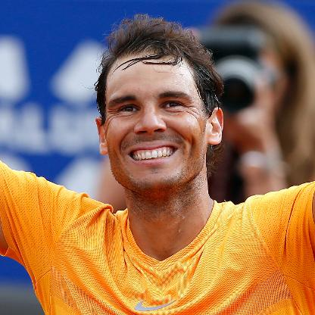
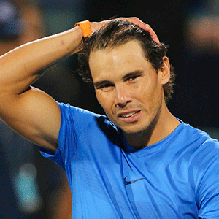
Reference image for Rafael Nadal
One Shot learning
Siamese Network
High Similarity Score (Close to 1)
I.e Test image belongs to Rafael Nadal
High Similarity score indicates same class
Test Image

Slide 14
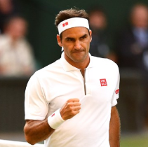
Reference image for Rafael Nadal
One Shot learning
Siamese Network
Low Similarity Score (Close to 0)
I.e Test image does not belongs to Rafael Nadal
Low Similarity score indicates different classes
Test Image

Slide 15
What happens if a new person join the company?
We require only a single image of the person
(to store as reference image in database).
No need to retrain the model.

Slide 16
Training a Siamese Network

Slide 17
Training Siamese Network
Features of image 1
Image 1
Network 1
Calculate similarity Score
Shared Weights
Image 2
Network 2
Features of image 2
Model is trained to predict Similarity Score
(and not directly classification)

Slide 18
Training Siamese Network
Features of image 1
Image 1
Network 1
Calculate similarity Score
Shared Weights
Image 2
Network 2
Features of image 2
In practice, both Network1 and Network2 are same models.

Slide 19
Training Siamese Network
Features of image 1
Image 1
Network 1
Calculate similarity Score
Shared Weights
Image 2
Network 2
Features of image 2
Training requires 2 images per example e.g Pairwise Learning

Slide 20
How to measure Distance or Similarity between features?
Distance
L2 Norm of distance (e.g Euclidean distance)
L1 Norm of distance (Manhattan)
Similarity
Cosine Similarity
Train a layer to calculate similarity

Slide 21
Training Siamese Network
Features of image 1
Image 1
Network 1
Calculate Euclidean distance
Shared Weights
Image 2
Network 2
Features of image 2
e.g for similarity score, we can calculate Euclidean distance

Slide 22
How to calculate loss for Siamese Network?

Slide 23
Loss function
Positive Example
Anchor Image
Calculate dissimilarity Score
D_{p}
This should be low

Slide 24
What else do we try to keep low in ML Model training?
Loss

Slide 25
Loss function
For similar inputs, we will use Distance as Loss function
Positive Example
Anchor Image
Calculate dissimilarity Score
Loss = D_{p}
D_{p}
This should be low

Slide 26
Loss function
For dissimilar inputs, we will use -(Distance) as Loss function
Anchor Image
Negative Example
Calculate dissimilarity Score
Loss = -D_{n}
D_{n}
This should be high!

Slide 27
Triplet Loss function
Positive Example
Anchor Image
Negative Example
Calculate dissimilarity Score
Calculate dissimilarity Score
This should be low!
This should be high!
Loss = D_{p} - D_{n}

Slide 28
Triplet Loss function
Positive Example
Anchor Image
Negative Example
Calculate dissimilarity Score
Calculate dissimilarity Score
This should be low!
This should be high!
https://arxiv.org/abs/1703.07737

Slide 29
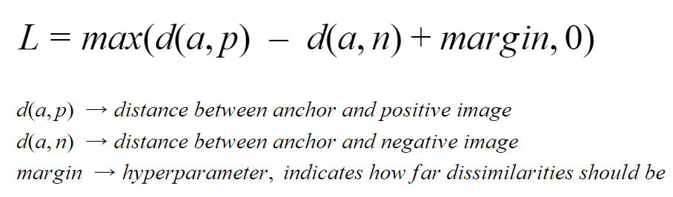
Triplet Loss function

Slide 30
Some applications of Siamese Network
Face Recognition
Signature Matching

Slide 31
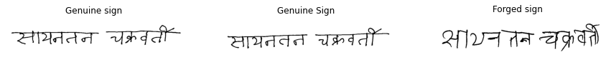
Exercise
Signature Matching

Slide 32
Update weights
Features of image 1
Signature
Image 1
Mobilenet
(pre-trained model)
Calculate Euclidean distance
Triplet Loss
Gradient Descent
Shared Weights
Signature
Image 2
Mobilenet
(pre-trained model)
Features of image 2
Training Signature matching Network

Slide 33
Features of image 1
Signature
Image 1
Mobilenet
(pre-trained model)
What distance value will tell us that images are genuine OR forged?
Calculate Euclidean distance
Shared Weights
Signature
Image 2
Mobilenet
(pre-trained model)
We need to find a
distance threshold value based on Test data… it can be distance value where Test accuracy is highest!
Features of image 2
Model Prediction
Signature matching Network

Slide 34
Update weights
Features of image 1
Signature
Image 1
Mobilenet
(pre-trained model)
Probability of images being similar
Concatenate
Dense
1 Neuron
Sigmoid
Loss
(Binary
Cross-Entropy)
Gradient Descent
Shared Weights
Signature
Image 2
Mobilenet
(pre-trained model)
Features of image 2
Training Signature matching Network
Using a trainable layer to learn Similarity

